Slide 1

CREDIT Risk analysis
Mohammed Anas Javeed

Slide 2
Risk Analysis conducted on following parameters
Customer Income & Credit Amount
Education Status of customer and Income
Education Status of customer and Credit Amount
Loan Purpose and Approval Status
Organization based on non-default customers
Previous credit of customer against loan purpose
Previous credit of customer against housing

Slide 3
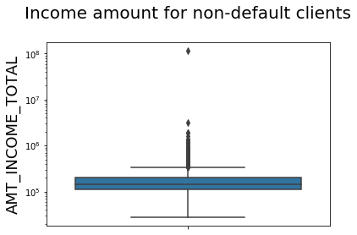
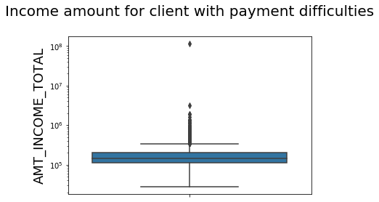
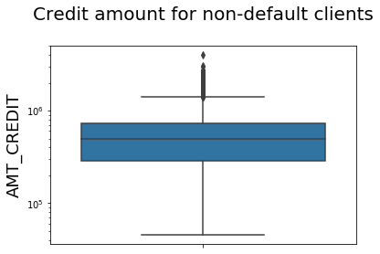
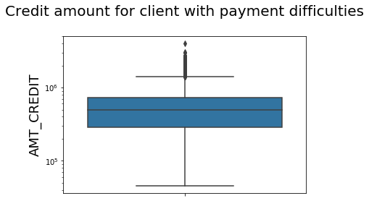
Customer Income & Credit Amount
The Credit amount & Income of customer is independent of loan credit risk.

Slide 4
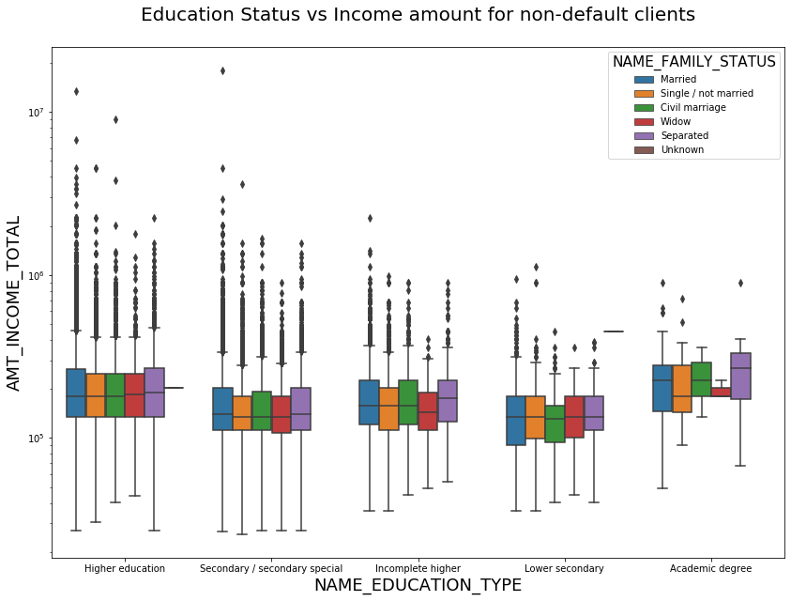
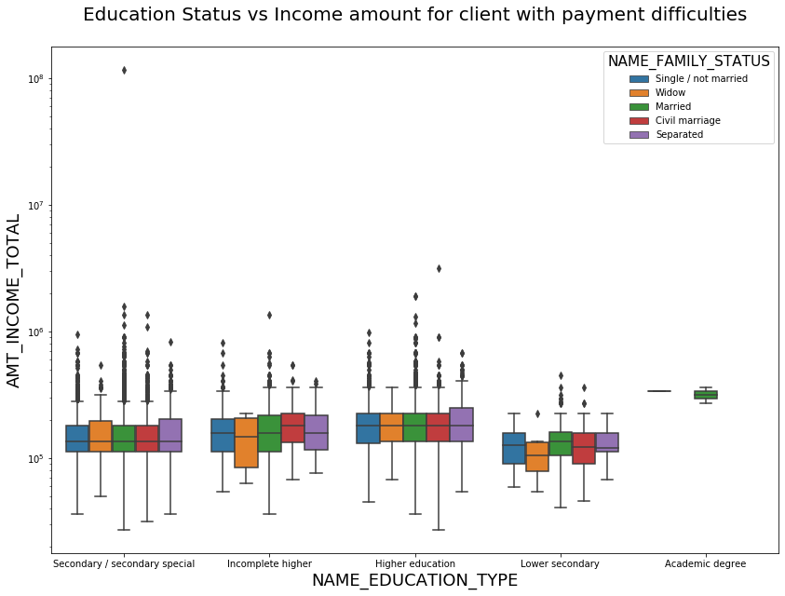
The higher amount of clients who have payment difficulties are those who have incomplete higher education.
We can infer from the below graph, the most likely defaulters are those with incomplete higher education, especially widows.
Education Status of customer and Income

Slide 5
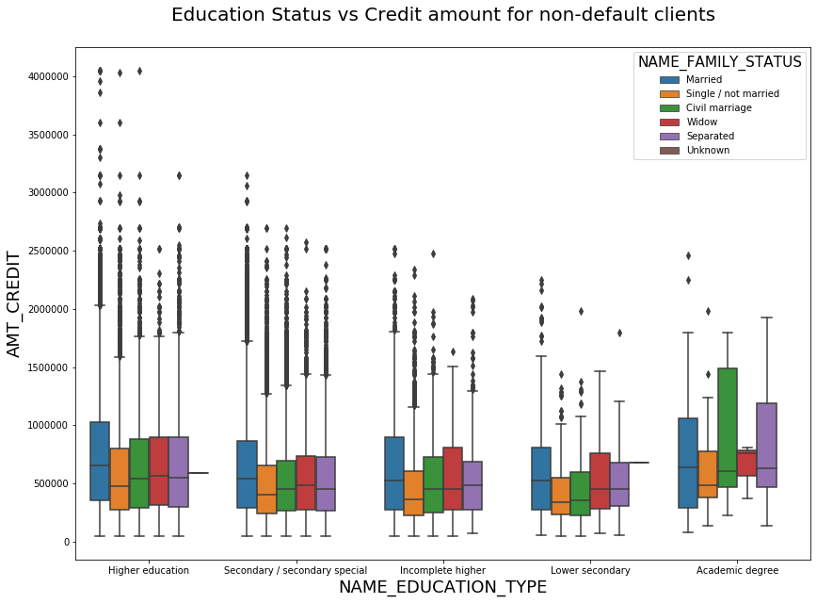
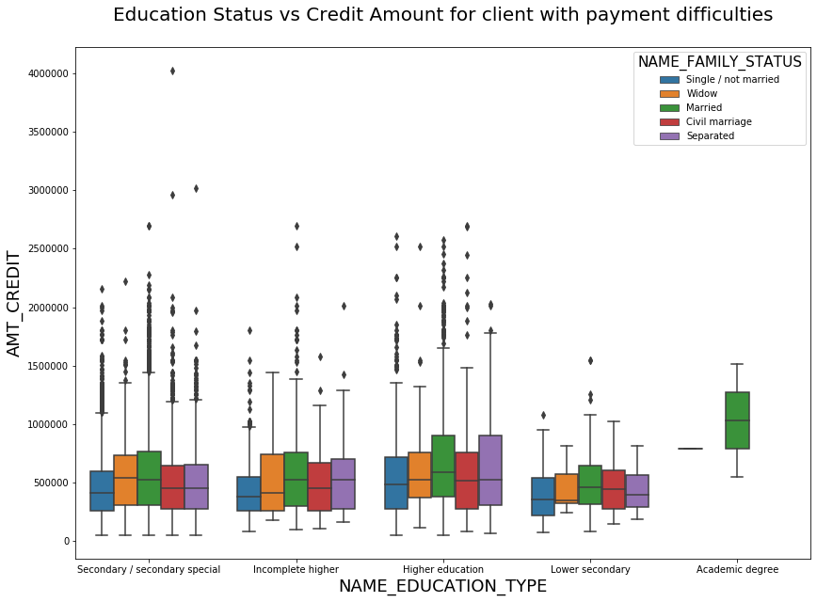
Customers with martial status Married and with an Academic degree are the largest defaulters as well as the largest pool of credit takers.
Which means they are the largest target group to take a loan but as unlikely as to pay it back.
Education Status of customer and credit amount

Slide 6
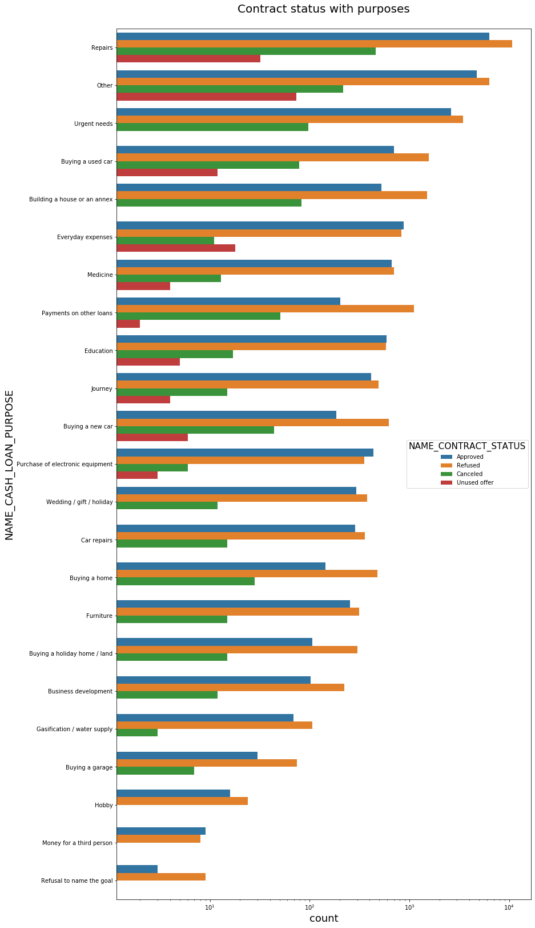
We observe that majority of the loans were taken for Repairs purpose.
We also observe that, the rejection rate for “Payment of other loans” is higher compared to its approval rate.
Loan Purpose and Approval Status

Slide 7
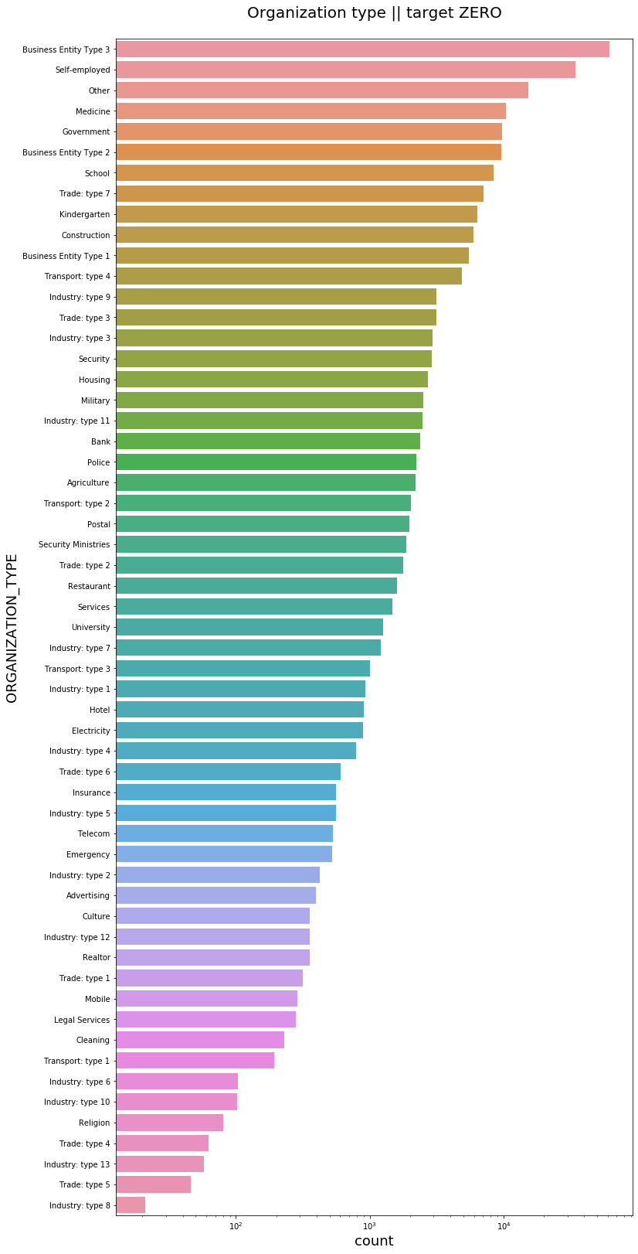
Industry type's, trade and religious institutions have a higher percentage of risk
Business entity - type 3, Self employed, other and Medicine are the safest categories to loan money
Organisation based on non-default customers

Slide 8
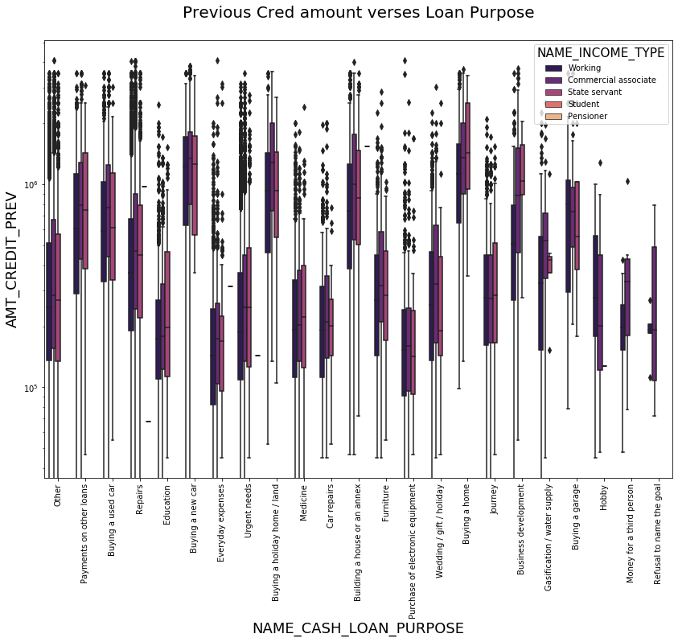
Previous credit of customer against loan purpose

Slide 9
- We observe that in previous credit, the highest amount of credit was taken for buying house by the State servant income type.
- The maximum credit amounts were taken for buying assets like home, car and land followed by payment for other loans and buying used cars. The uptake for buying a garage is also high.
- A recommendation would be to promote loan for car and garage together to increase the uptake of the latter.
- Also, the used car segment can be promoted widely to Students as the uptake is highest there.

Slide 10
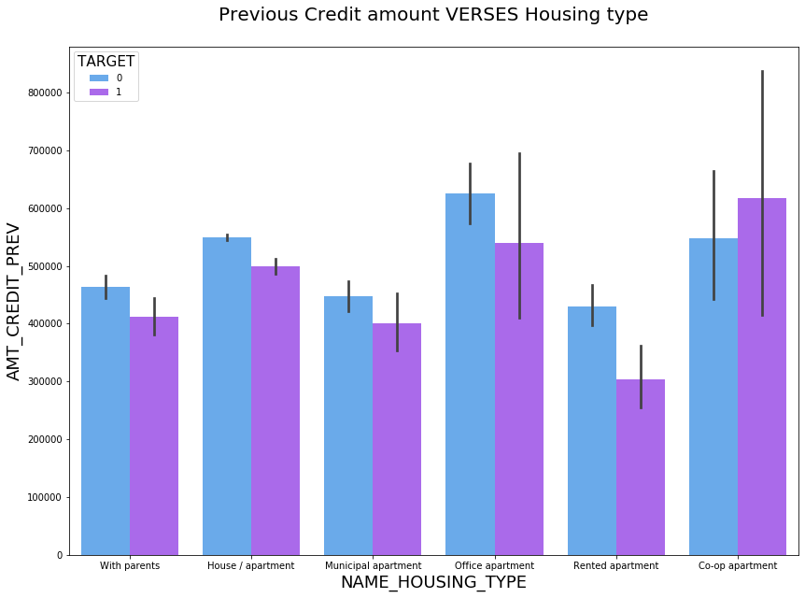
Those living in rented or office apartments have lesser default ratio.
Previous credit of customer against housing

Slide 11
Conclusion
As per above observations, the following have been identified as drivers of default:
1.Client with incomplete higher education
2.Clients with Family status as Widows
3.Clients housing in Co-op apartments
It was also observed that,
1.Maximum credit amounts were taken for buying assets like home, car and land followed by payment for other loans and buying used cars.
2.Based on organization type, Business entity -type 3, Self employed, other and Medicine are the safest categories to loan money.
3.Customers with martial status Married and with an Academic degree are the largest defaulters as well as the largest pool of credit takers.

